Slide 1
Masters in Computer Vision Software Engineering Project 2013 – 2014 "YoMap"
Oksana Hagen
Natalia Shepeleva
Emre Ozan Alkan
Klemen Istenič

Slide 2

Recognize the situation?

Slide 3

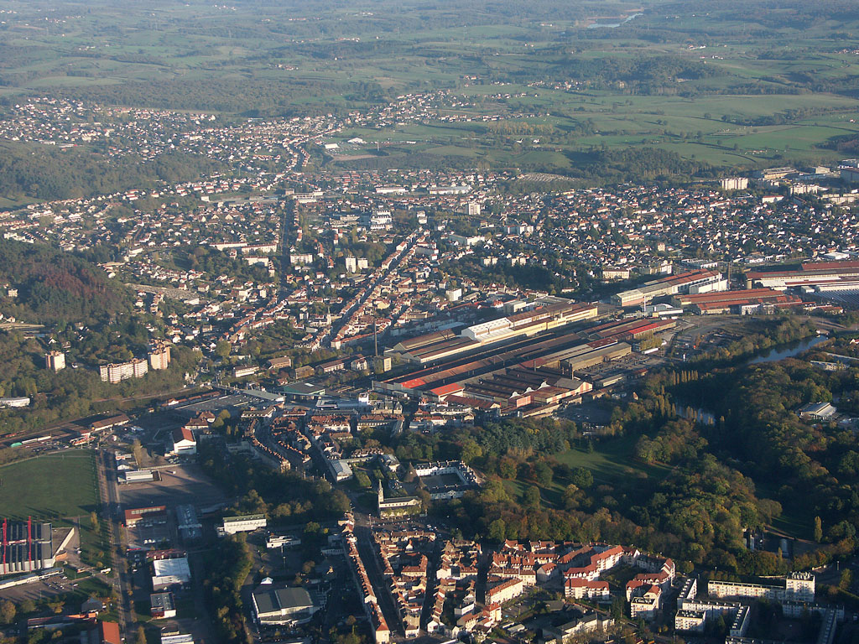
Big city – A lot of POI‘s
Small city – ...

Slide 4
Project Requirements
Map application

Slide 5
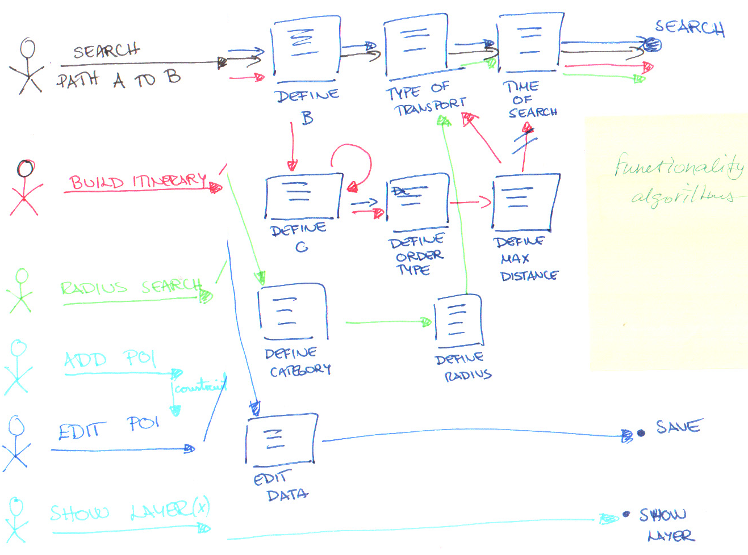
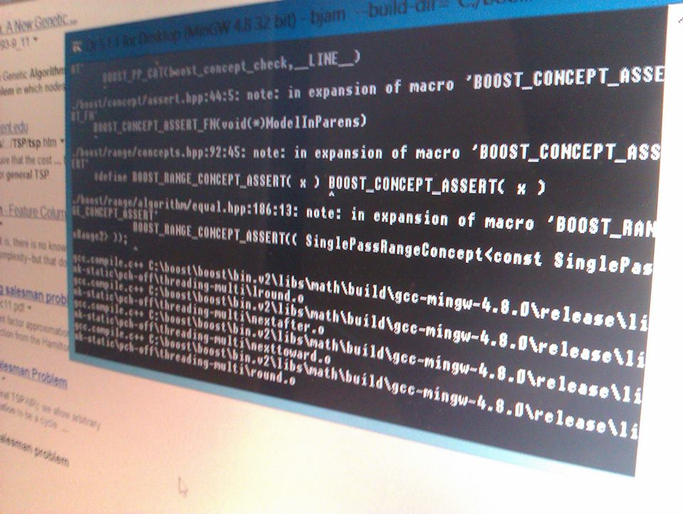
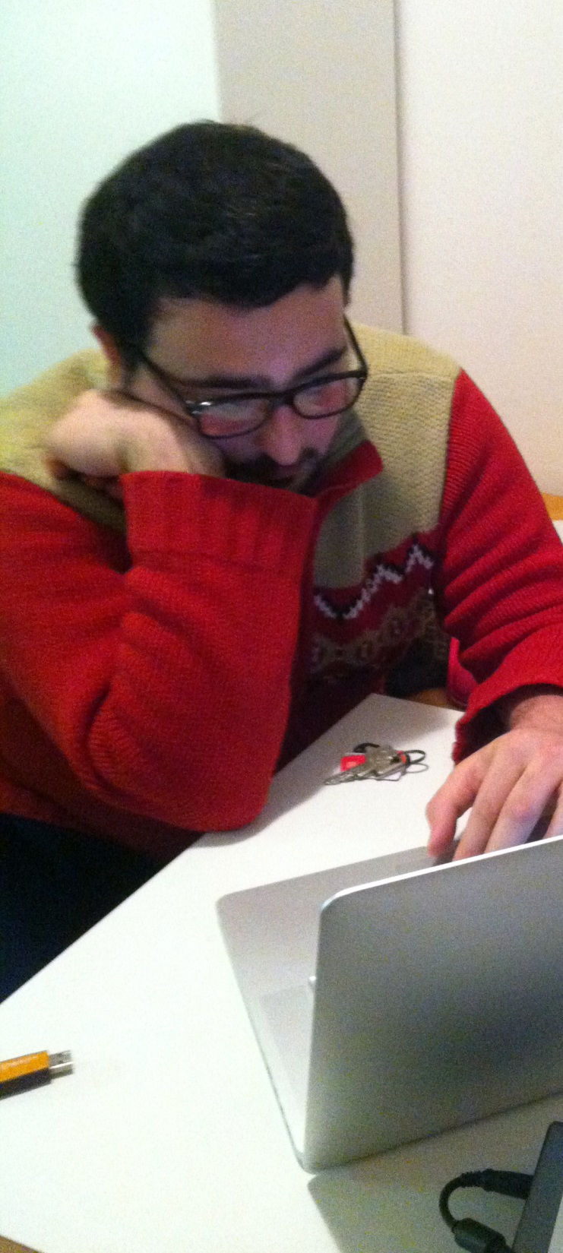
Project progress
2D
Analysing the problem

Slide 6
Project progress
2D
Pre-implementation stage

Slide 7
Project progress
2D
Implementation stage

Slide 8
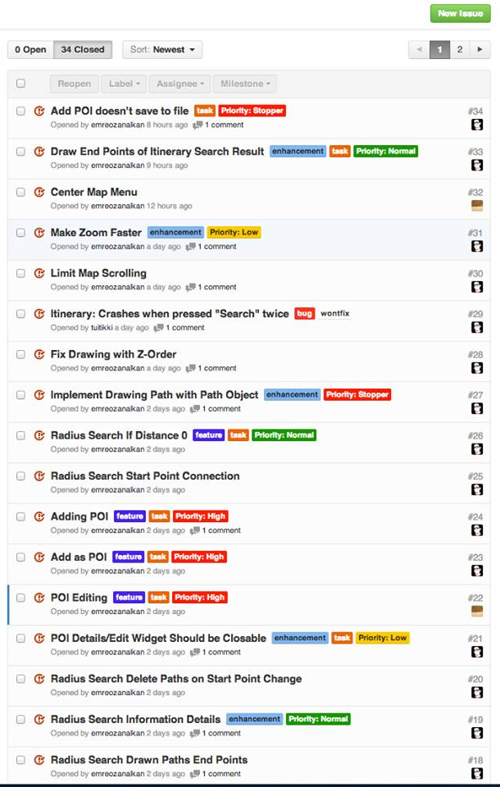



Software for project management

Slide 9
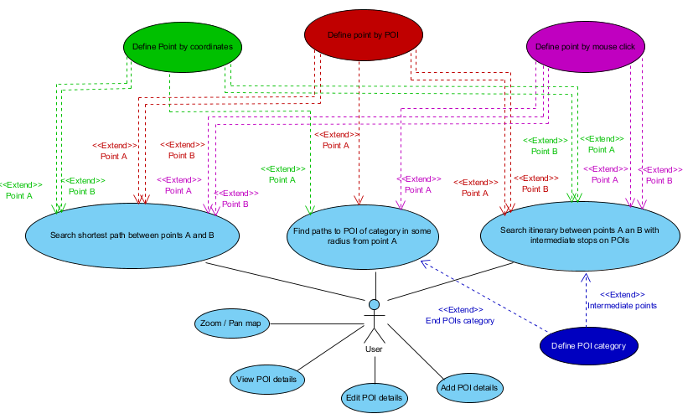
User requirements
Use case diagram

Slide 10
Plan of implementation
Path Algorithms
Database and Data stuctures
Project
User Interface
Map representation
Matlab
C++
C++
Matlab

Slide 11
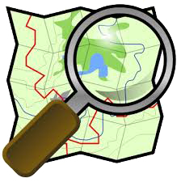
Data sources
Points of Interest
Map data
Dynamic
Static
Collaborated with other group
OpenStreetMaps
170 POI and 26 categories
Open Database License (ODbL) from Open Data Commons (ODC)
Location
Name
Address
Category
Photo

Slide 12
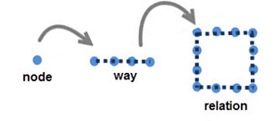
OpenStreetMaps
Four core elements:
Node
Way
Relation
Tag

Slide 13
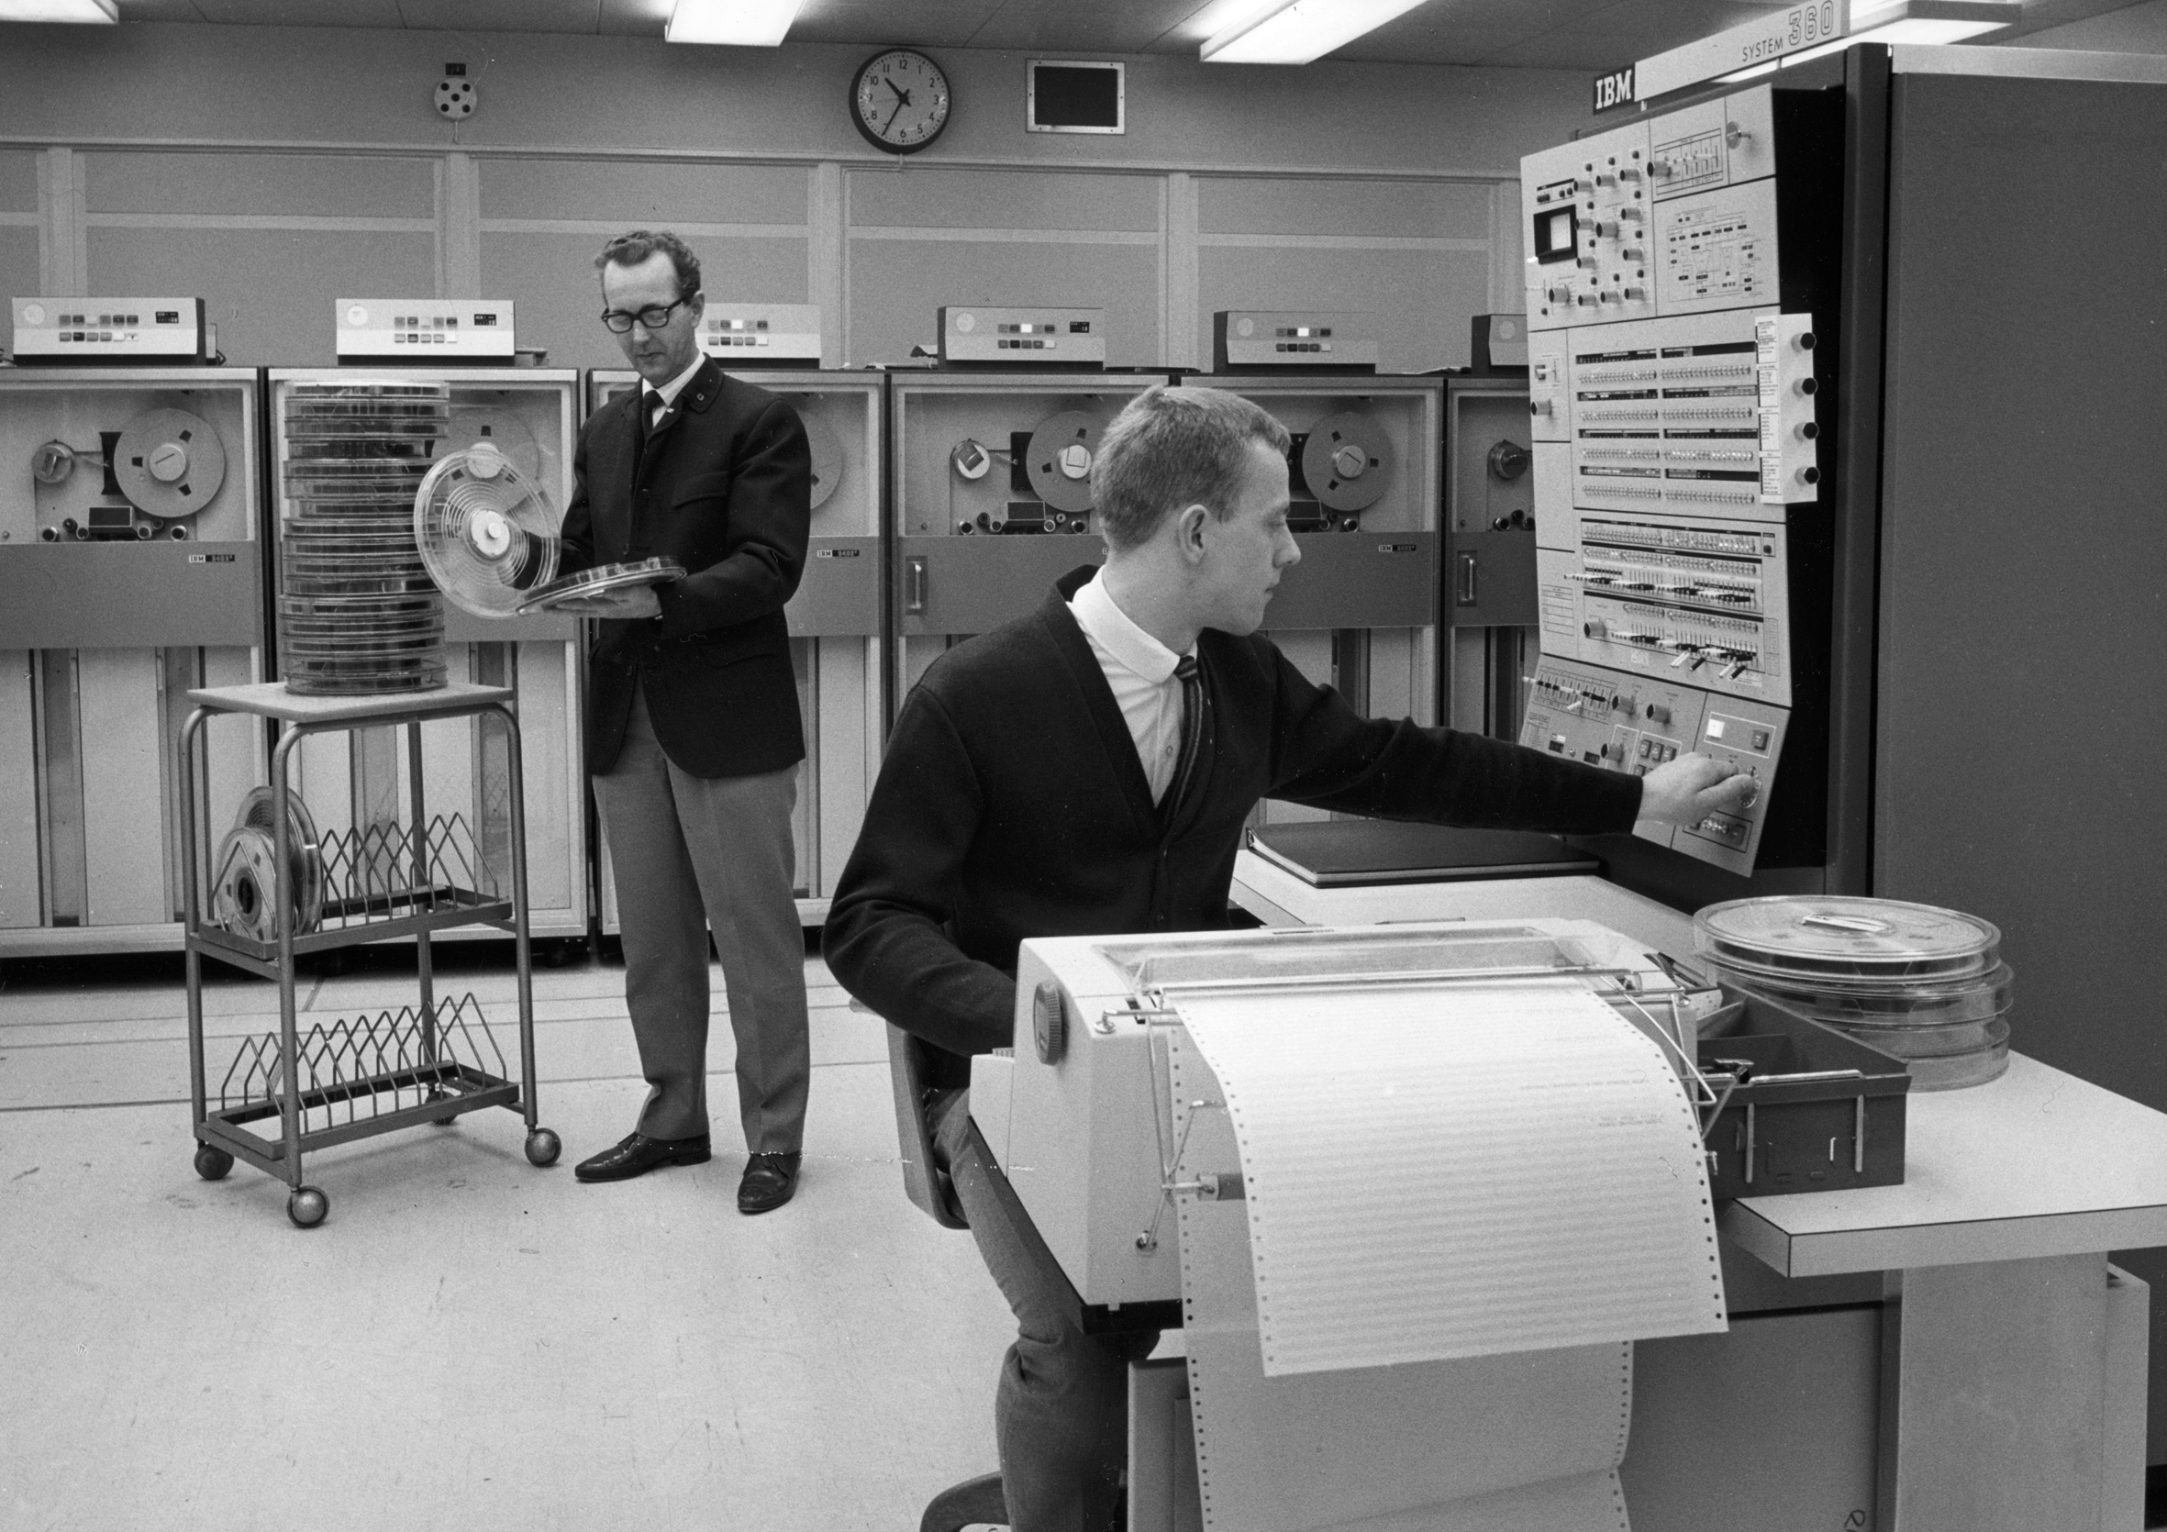
Relational vs. XML based database
Reasons for XML:
fsdadsadsa
Most of the data is static
Dynamic data will rarely change
Relatively small amount of data
Easiness of install and mobility
Disadvantage: Data saved into a file

Slide 14
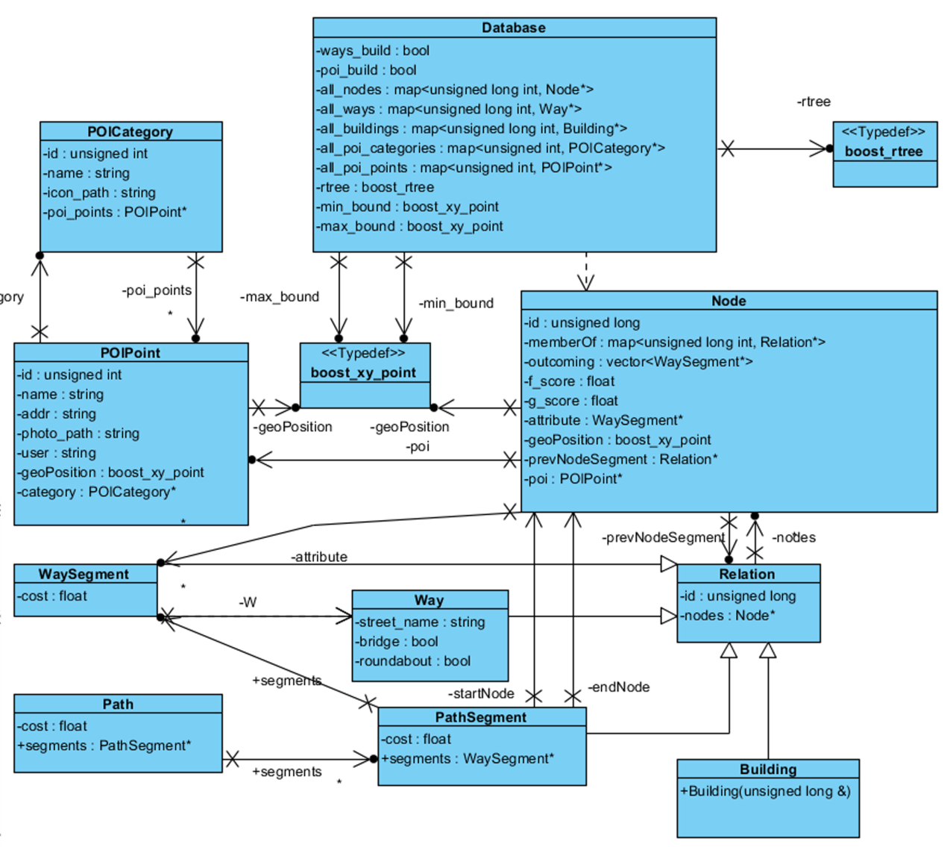
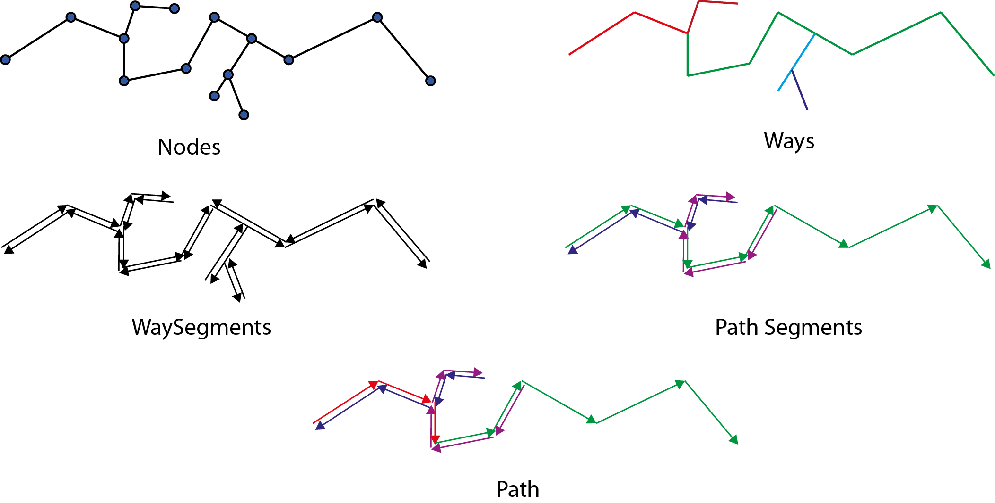
Data structure

Slide 15
Data structure

Slide 16
Database class
Containers
nekoč...

Slide 17
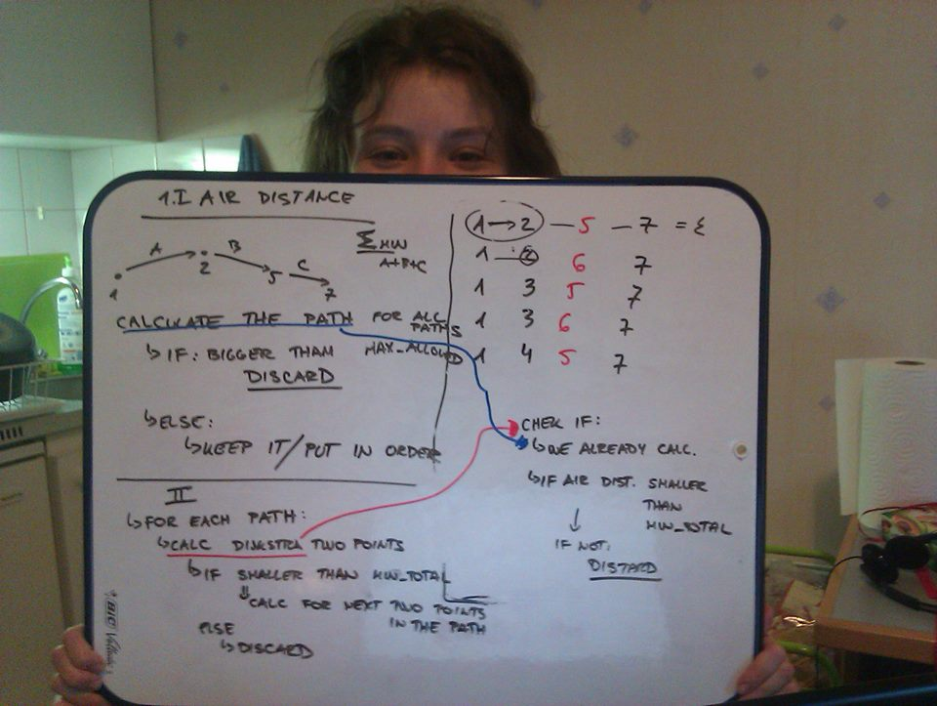
Path algorithm

Slide 18
What do we want
All are actually finding a path between point A and B
Single-pair shortest path problem

Slide 19
Possible algorithms
Dijkstra‘s
A* search
Bellman – Ford
Floyd – Warshall

Slide 20
Possible algorithms
Dijkstra‘s
A* search
Selected
Bellman – Ford
Floyd – Warshall

Slide 21
A* search algorithm
Combines the benefits of:
Dijkstra‘s algorithm (favoring the closest node)
Best-First-Search algorithms (favoring closest node to the target)
Traverse the graph node by node
selecting node with smallest cost

Slide 22
Snap to road
A* algorithm searches from node to node
User can select any point on map
Find closest node
Road snapping function

Slide 23
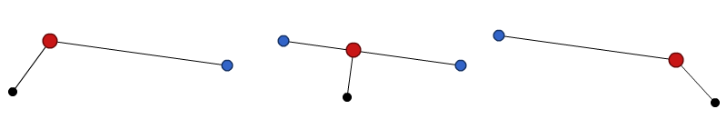
Road snapping function
Finds WaySegment that has closest perpendicular point (start point)
Connect perpendicular point to end nodes of the segment

Slide 24
Implementation in C++
Compare all WaySegments
Find a couple of close ones and compare
Use rtree for spatial filtering according to
Intersection with bounding box of ws
Instead of thousands of operations→just a few

Slide 25
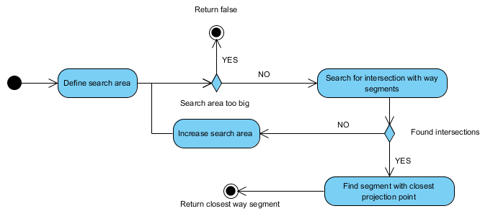
Implementation in C++
Find a couple of close ones and compare
Use rtree for spatial filtering according to
Intersection with bounding box of ws

Slide 26
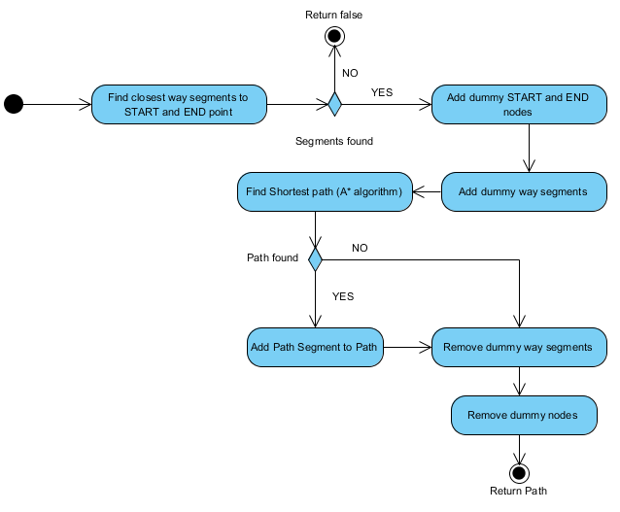
Shortest path A→B

Slide 27
Radius search
Find all possible ways between A and all POI of some category in radius
We first check air distances to eliminate too long
Defined custom compare function for path ordering in std::set

Slide 28
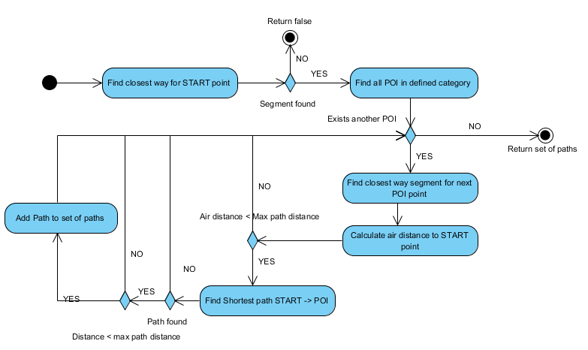
Radius search

Slide 29
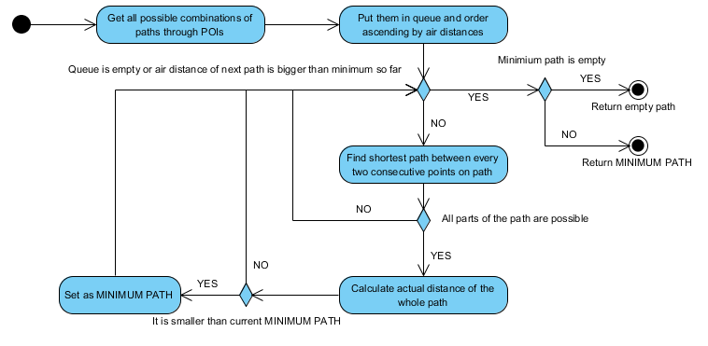
Itinerary search
Construct a path that connects start and end point and goes through one POI of each category selected

Slide 30
Itinerary search
Construct a path that connects start and end point and goes through one POI of each category selected
We stop when smallest path in queue is bigger than min path

Slide 31
Difficult framework choice
 | Qt Quick | Qt Widgets
Used language(s) | QML/JS | C++
Native look'n'feel |  | X
Custom look'n'feel | X
Fluid animated UIs | X
Touch screen ready | X
Standard industry widgets |  | X
Rapid UI development | X
Well-documented |  | X
Pretty | X
Practical |  | X

Slide 32
Structure of the UI in C++
Logic
Connected to Database and Algorithms
MainWindow
slots
slots
signals
signals
GLWidget
Map processing
Dialog
POI Editing

Slide 33
Qt OpenGL Integration Part 1
QGLWidget class for rendering OpenGL
QGLWidget provides functionality for displaying OpenGL graphics integrated into Qt
It’s simple to use
Inherit from it and use as subclass like other QWidgets
Either use QPainter or pure OpenGL

Slide 34
Qt OpenGL Integration Part 2
QGLWidget provides 3 virtual function to override
to easily use OpenGL
initializeGL(): Setting up OpenGL rendering context, called once on OpenGL start
resizeGL(): Handling setting up viewport, projections
and resize of application window
paintGL(): Where we rendering OpenGL scene. Called whenever updateGL() called or widget needs update

Slide 35
Qt OpenGL Integration Part 3
We sub classed QGLWidget as GLWidget
GLWidget doesn’t aware of our UI so we implemented Signals and Slots mechanism (kind of observer or publish-subscribe pattern) to communicate between objects.
GLWidget providing interfaces for UI to pass all ways, all buildings, POI, map bounds, search result and delete functions for these.

Slide 36
Qt OpenGL Integration Part 3
Class Node
Class GLPOIPoint
Map Border
Class Way : Relation
POI
Ways
OpenGL
Class Building : Relation
Buildings
Start/End Point
Paths
Class WaySegment : Relation
Class Path: Relation
Class PathSegment: Relation

Slide 37
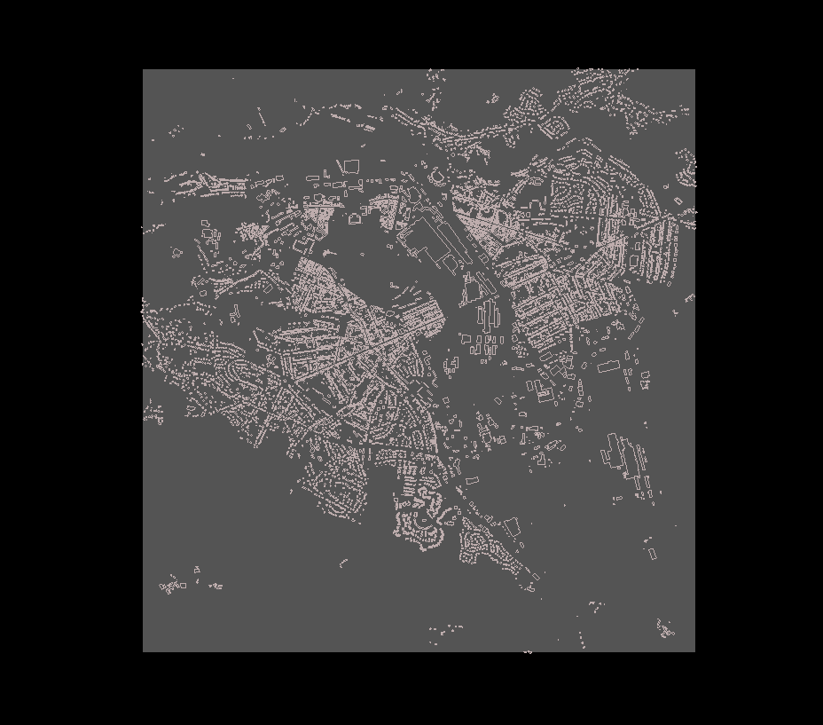
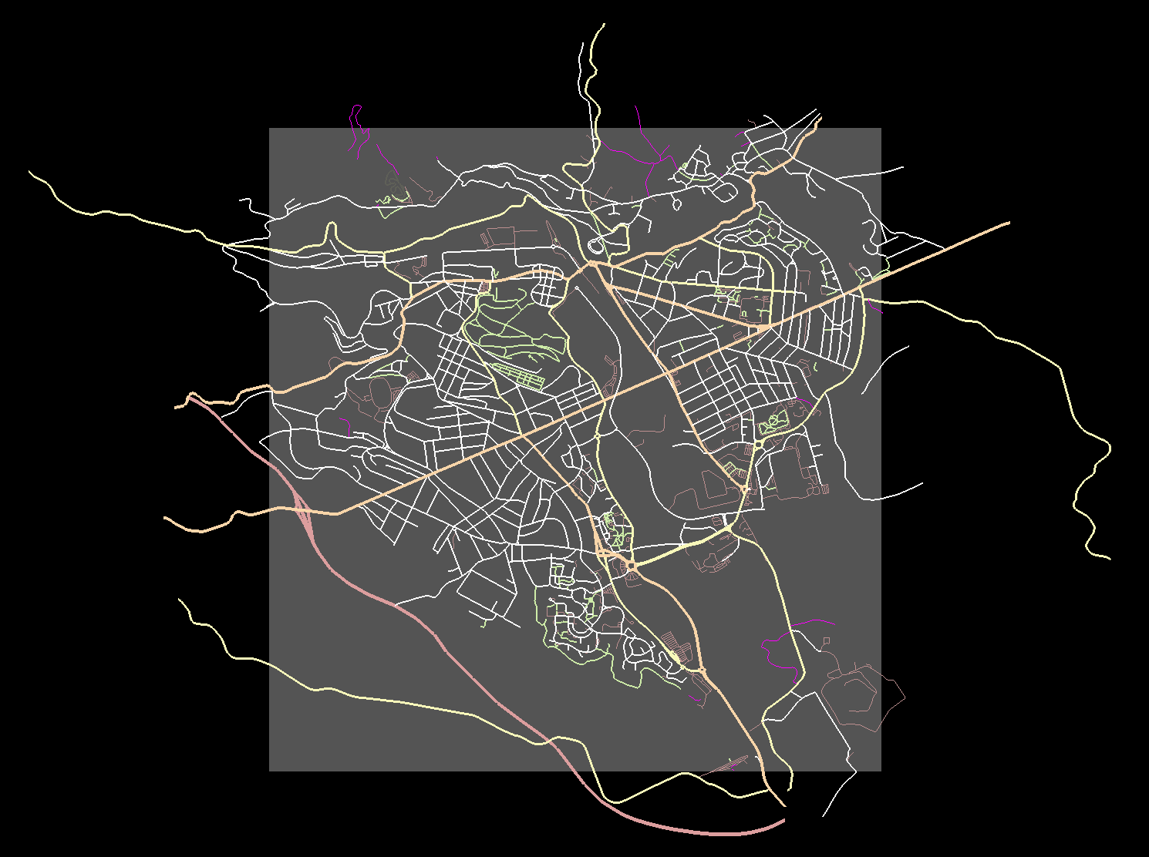

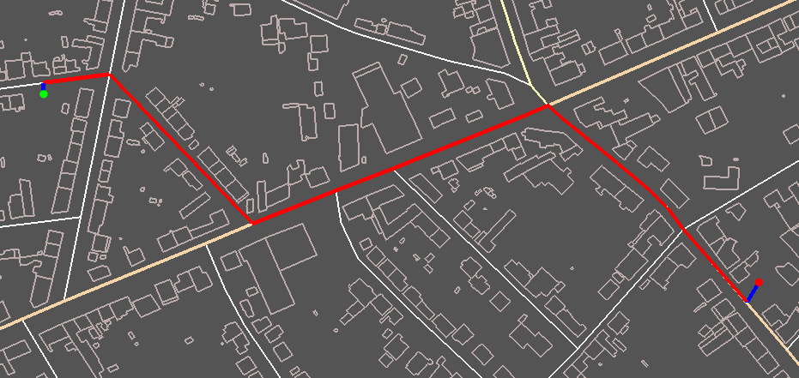
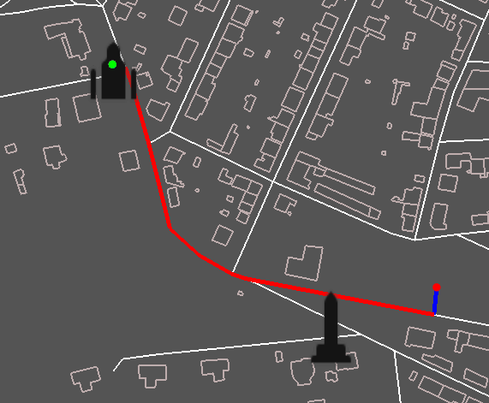
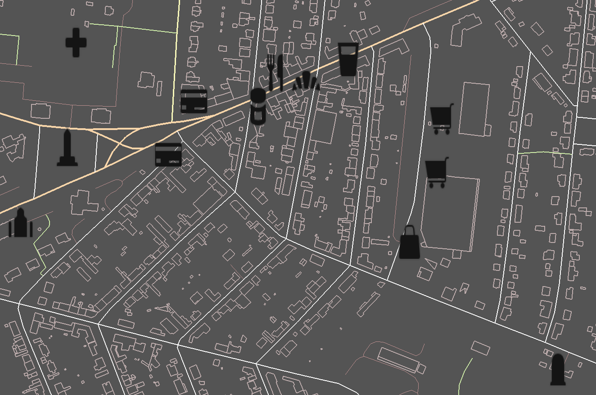
Map Border
Ways
Buildings
Paths
Start/End points
Points of interest

Slide 38
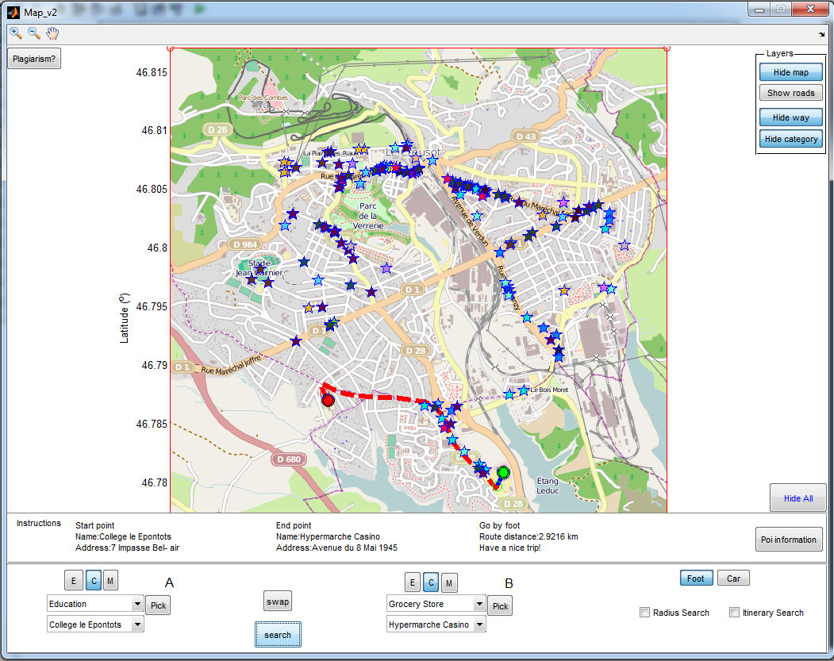
Matlab GUI
GUIDE Layout Editor
Functional:
3 types of search
map/roads/POI representation
Path information
Point swapping
Transport ypes
3 possibilities of data enter
Hide / show panel

Slide 39
Main issues
Map plotting
Dots plotting
OpenStreetMap Library
handles
Map bounds
Dot as an extra layer
Layers representation
Mouse click
Pick coordinates

Slide 40
C++ vs Matlab
 | C++ | MATLAB
Computational resources usage | very light | extremely heavy
Functions and toolboxes | harder to use | easier to use
Variable declaration | compulsory | not required
Global functions | global in all program | only if declared in function
Plots & drawings | external libraries | very easy
GUI creation | lots of possibilities | GUIDE or your code
Price | free of charge | expensive

Slide 41
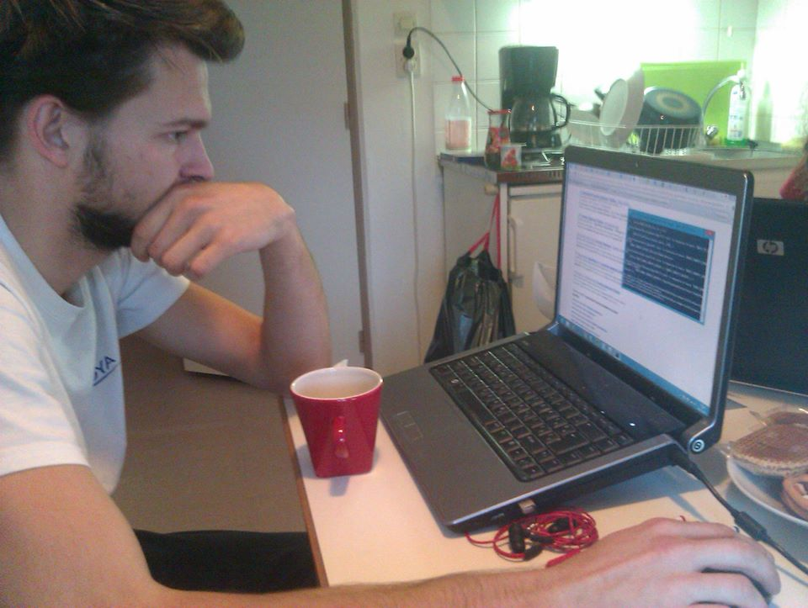
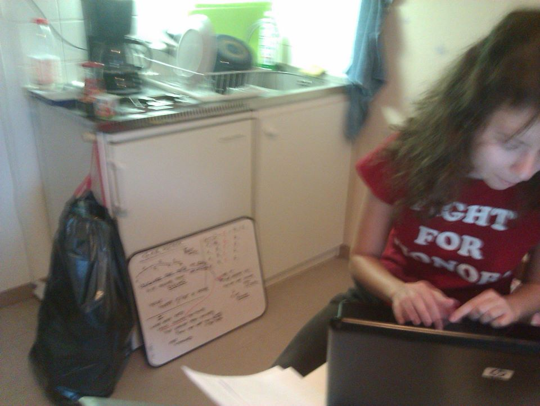
We‘ve learned a lot about software engineering
...but we have also learned...

Slide 42

How to work in an international
team

Slide 43
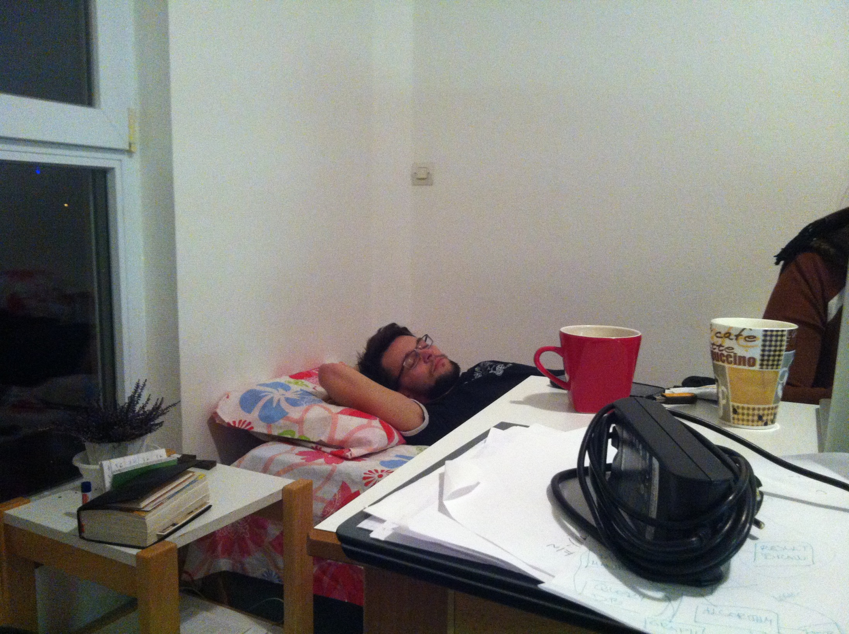
Proper time management
Sleep while building or compiling...

Slide 44

Sometimes we learn stuff we don‘t
need
QML...Does anybody see it?

